Slide 1
AKS Document For Developer

Slide 2
Index
Application Design and Build
a. AKS Cluster Architecture and components define
b. Life Cycle of an Application request in AKS Cluster
c. Define and build container images
d. Container Registries
2. Application Deployments
a. Deployment strategies
b Helm package manager to deploy existing packages
3. Application Observability and Maintenance
a. Probes and health checks (Liveness, Readiness)
b. Monitor Kubernetes Applications
d. AKS Cluster and tools Upgradation

Slide 3
Index
4. Application Environment, Configuration and Security
a. Namespace, Resource requirements, Limits and Quotas
b. Authentication, Authorization and Admission Control
c. Secrets
d. Security Contexts
5. Services and Networking
a. Network Policies
b. Access to application via services
c. Ingress to expose applications

Slide 4
Application Design and Build

Slide 5
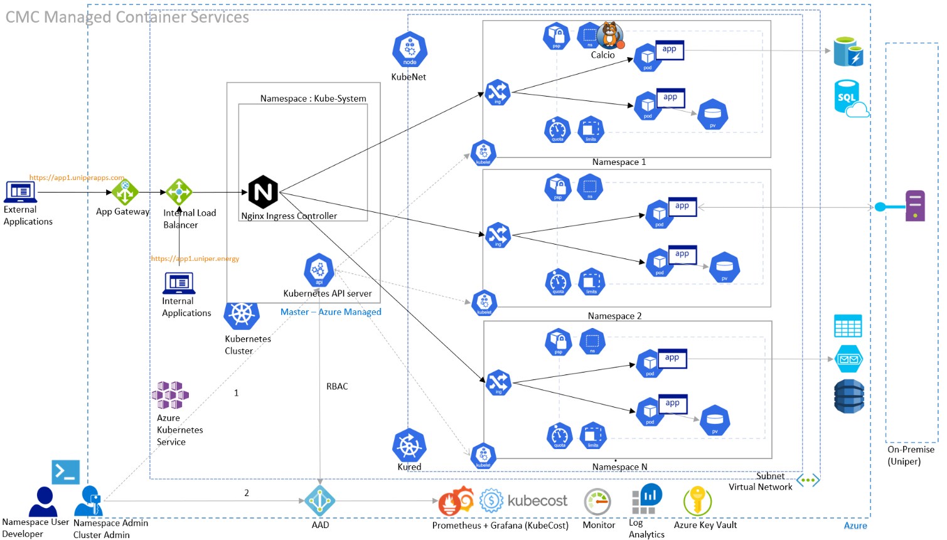
AKS Cluster Architecture

Slide 6
AKS Cluster Components (1/3)
Application Gateway:Application Gateway works at the application layer (Layer 7 in the OSI network reference stack). It acts as a reverse-proxy service, terminating the client connection and forwarding requests to back-end endpoints. It can be used for SSL offloading. Application gateway will also provide URL filtering for users accessing applications through it and an integrated Web Application Firewall.
Uniper will use Application gateway in the hub Subscriptions to route traffic for http/https requests from on premise users to Web applications in the spoke subscriptions. Application gateways will only use private IP Addresses.
Kubenet:. HaCT Managed clusters will be created using VNET integration and Kubenet networking. This means that a dedicated subnet with a specified IP range will be assigned to the AKS cluster with private IP addresses. Each AKS cluster will have its own internal overlay network and DNS service for use inside the AKS cluster. With Kubenet networking each node in the AKS cluster will get an IP from the assigned subnet while Pods will not get an IP from the subnet.
The Kubenet networking model allows to run a large number of Pods inside the same cluster without consuming a large range of IP addresses.
With kubenet, only the nodes receive an IP address in the virtual network subnet. Pods can't communicate directly with each other. Instead, User Defined Routing (UDR) and IP forwarding is used for connectivity between pods across node.

Slide 7
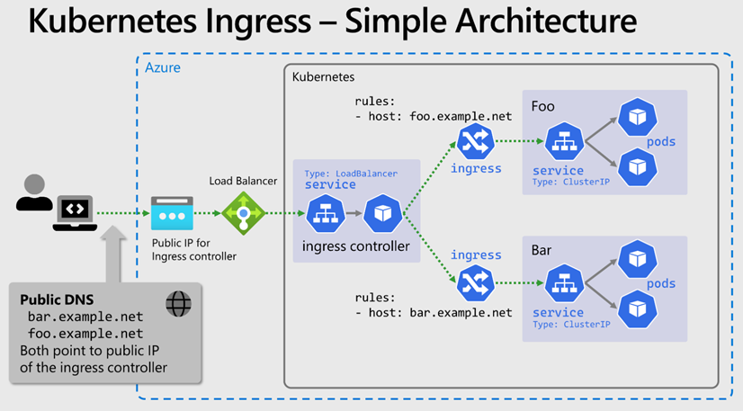
AKS Cluster Components (2/3)
Nginx Ingress
An ingress controller is a piece of software that provides reverse proxy, configurable traffic routing, and TLS termination for Kubernetes services. Kubernetes ingress resources are used to configure the ingress rules and routes for individual Kubernetes services. Using an ingress controller and ingress rules, a single IP address can be used to route traffic to multiple services in a Kubernetes cluster. Nginx ingress controller is one widely used software which can be imported via helm as well.
In order to have communication into the AKS cluster a managed Nginx ingress controller is provided by HaCT inside the AKS system namespace. This ingress controller should be used by all applications for ingress traffic.
API Server :- It receives the request & persists the deployment details or object definition to the database.
Etcd: It is a crucial component for Kubernetes as it stores the entire state of the cluster: its configuration, specifications, and the statuses of the running workloads.

Slide 8
AKS Cluster Components (3/3)
Scheduler :The Kubernetes scheduler is a control plane process which assigns Pods to Nodes. The scheduler determines which Nodes are valid placements for each Pod in the scheduling queue according to constraints and available resources. The scheduler then ranks each valid Node and binds the Pod to a suitable Node.
Node selection in kube-scheduler
kube-scheduler selects a node for the pod in a 2-step operation:
1.Filtering 2.Scoring
The filtering step finds the set of Nodes where it's feasible to schedule the Pod.
In the scoring step, the scheduler ranks the remaining nodes to choose the most suitable Pod placement.
Finally, kube-scheduler assigns the Pod to the Node with the highest ranking.
Also, Scheduler work with Taint and Tolerations for POD schedule. Taints and tolerations allow the node to control which pods should (or should not) be scheduled on them. A taint allows a node to refuse pod to be scheduled unless that pod has a matching toleration. We apply taints to a node through the node specification (NodeSpec) and apply tolerations to a pod through the pod specification (PodSpec). A taint on a node instructs the node to repel all pods that do not tolerate the taint.
Kubelet: It retrieves the template for the Pods and delegates creating the container to the Docker daemon.
When the Docker daemon completes the task, the kubelet checks readiness and liveness probes and the Pod is finally marked as running.
Kubectl:- It converts the yaml resource into JSON and sends it to API Server inside the master node or control plane.

Slide 9
Life Cycle of an Application request in AKS Cluster (1/2)
Consider a scenario where Tom wanted to create an Application pod kubectl create -f pod.yaml which says 4 replicas in pod configuration and with a service already created on Worker Node
Here is the flow of request:
Step 1: User (Tom) who has K8 Cluster access wants to create a Application pod. Now this request will be sent to kube-apiserver at step 1. kube-apiserver compiles the request at this step and routes to etcd database
Step 2: The request will be routed from kube-apiserver to etcd database and at this step, etcd database saves the pod configuration you have requested and responds to kube-apiserver saying it saved all the data requested by server
Step 3: Now “kube-apiserver” will send request to kube-controller-manager to create pods. In this case as we are creating pods, pod controller manager component will create a task or job to create pod and responds back to kube-apiserver

Slide 10
Life Cycle of an Application request in AKS Cluster (2/2)
Step 4: Now kube-apiserver will route request to kube-scheduler. kube-scheduler will pick the task created by kube-controller-manager and scheduler will schedule the task to create pod as per pod specifications and route the request to kube-apiserver
Step 5: Now kube-apiserver will route request to worker node(s) which has different objects that are already created like services etc.
Step 6, 7: Inside worker node, when a request reaches the service virtual IP, the request is forwarded to one of the underlying pods. This is achieved by by using the rules that kube-proxy have created. kube-proxy usually runs in different modes like iptables, ipvs to route the request to pods.

Slide 11
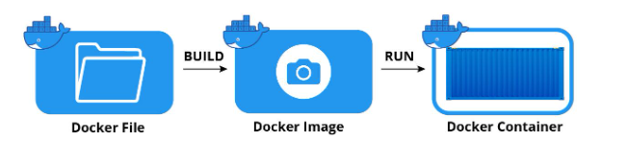
Define and build container images
What is Container Image
Container images are static bundles of files that represent everything a container runtime, like Docker, needs to run a container. Images include the filesystem layout, all the required applications and dependencies, and configuration.
A Docker image is made up of a collection of files that bundle together all the essentials – such as installations, application code, and dependencies – required to configure a fully operational container environment. You can create a Docker image by using one of two methods:
Interactive: By running a container from an existing Docker image, manually changing that container environment through a series of live steps and saving the resulting state as a new image.
Dockerfile: By constructing a plain-text file, known as a Dockerfile, which provides the specifications for creating a Docker image.

Slide 12
Docker File Statements
Command | Purpose
FROM | To specify the parent image.
WORKDIR | To set the working directory for any commands that follow in the Dockerfile.
RUN | To install any applications and packages required for your container.
COPY | To copy over files or directories from a specific location.
ADD | As COPY, but also able to handle remote URLs and unpack compressed files.
ENTRYPOINT | Command that will always be executed when the container starts. If not specified, the default is /bin/sh -c
CMD | Arguments passed to the entrypoint. If ENTRYPOINT is not set (defaults to /bin/sh -c), the CMD will be the commands the container executes.
EXPOSE | To define which port through which to access your container application.
LABEL | To add metadata to the image.

Slide 13
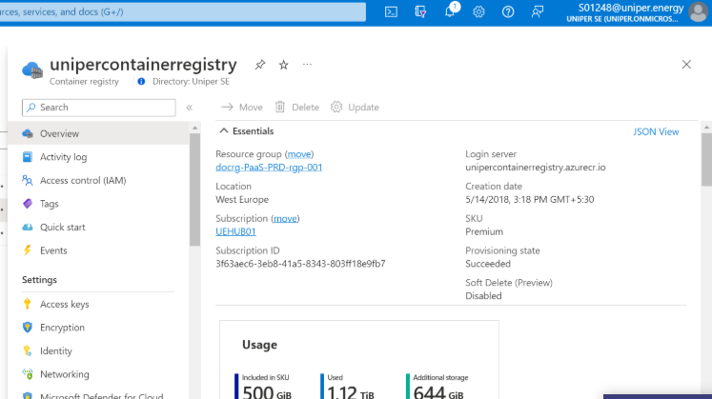
Container Registries
Uniper maintains a central managed Container Registry for all container images used for development, testing or production purposes. The Uniper Container Registry is configured for high-resilience and scanned for vulnerable images. Application teams are advised not to use any other Container Registry than the HaCT managed Uniper Container Registry.
If application teams feel the need to test integration scenarios with a container registry, they can approach the HaCT team to get access to an R&D test registry for temporary usage.
Azure Container Registry Maintenance
In order to control cost and complexity of the Uniper Container Registry old images are deleted regularly from the Uniper Container Registry. For this a deletion job is scheduled every Monday at 6.00 AM CET to delete old images from the Uniper container repository, i.e., all images except the last 7 images in each repository.
If you have a specific image that shall not be deleted (e.g., for audit reasons) you can exclude your image from scheduled deletion using a delete lock. It is recommended to lock an image when it is deployed to production so that you can keep a history of production images.
Container Registry for Applications images

Slide 14
Role Granter in AKS Cluster
Role Granter define the permissions to grant/create Roles and RoleBinding for Namespace Admin.
A ClusterRole can be used to grant the permissions as a Role, and it uses the rbac.authorization.k8s.io API Group to drive authorization decisions that allows Namespace admin to configure rules such as creating resources like below:
ClusterRole :-A ClusterRole grants and applies permissions to resources across the entire cluster, not a specific namespace.
ClusterRoleBinding:-Once you've defined roles to grant permissions to resources, you assign those Kubernetes RBAC permissions with a RoleBinding. If your AKS cluster integrates with Azure Active Directory (Azure AD), RoleBinding grant permissions to Azure AD users to perform actions within the cluster. See how in Control access to cluster resources using Kubernetes role-based access control and Azure Active Directory identities.
Roles:-Before assigning permissions to users with Kubernetes RBAC, you'll define user permissions as a Role. Grant permissions within a namespace using roles.
RoleBinding:-Assign roles to users for a given namespace using RoleBinding. With RoleBinding, you can logically segregate a single AKS cluster, only enabling users to access the application resources in their assigned namespace.
with following actions(verbs): "create", "get", "list", "watch", "update", "patch", "delete"
RoleBinding reference the ClusterRole to grant the permissions to resources defined in the ClusterRole and the users mentioned under subjects: will only be able to perform actions(verbs) on specified resources in the Role.

Slide 15
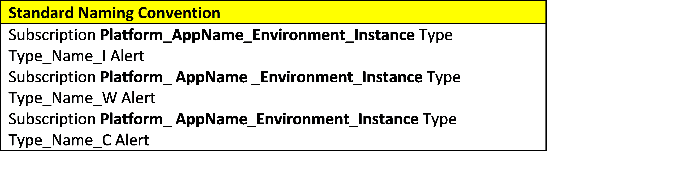
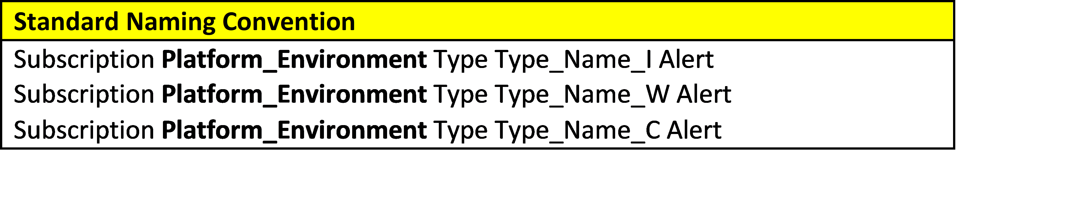
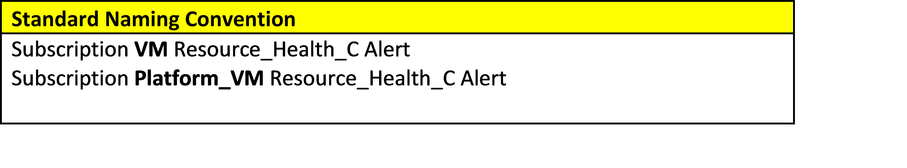
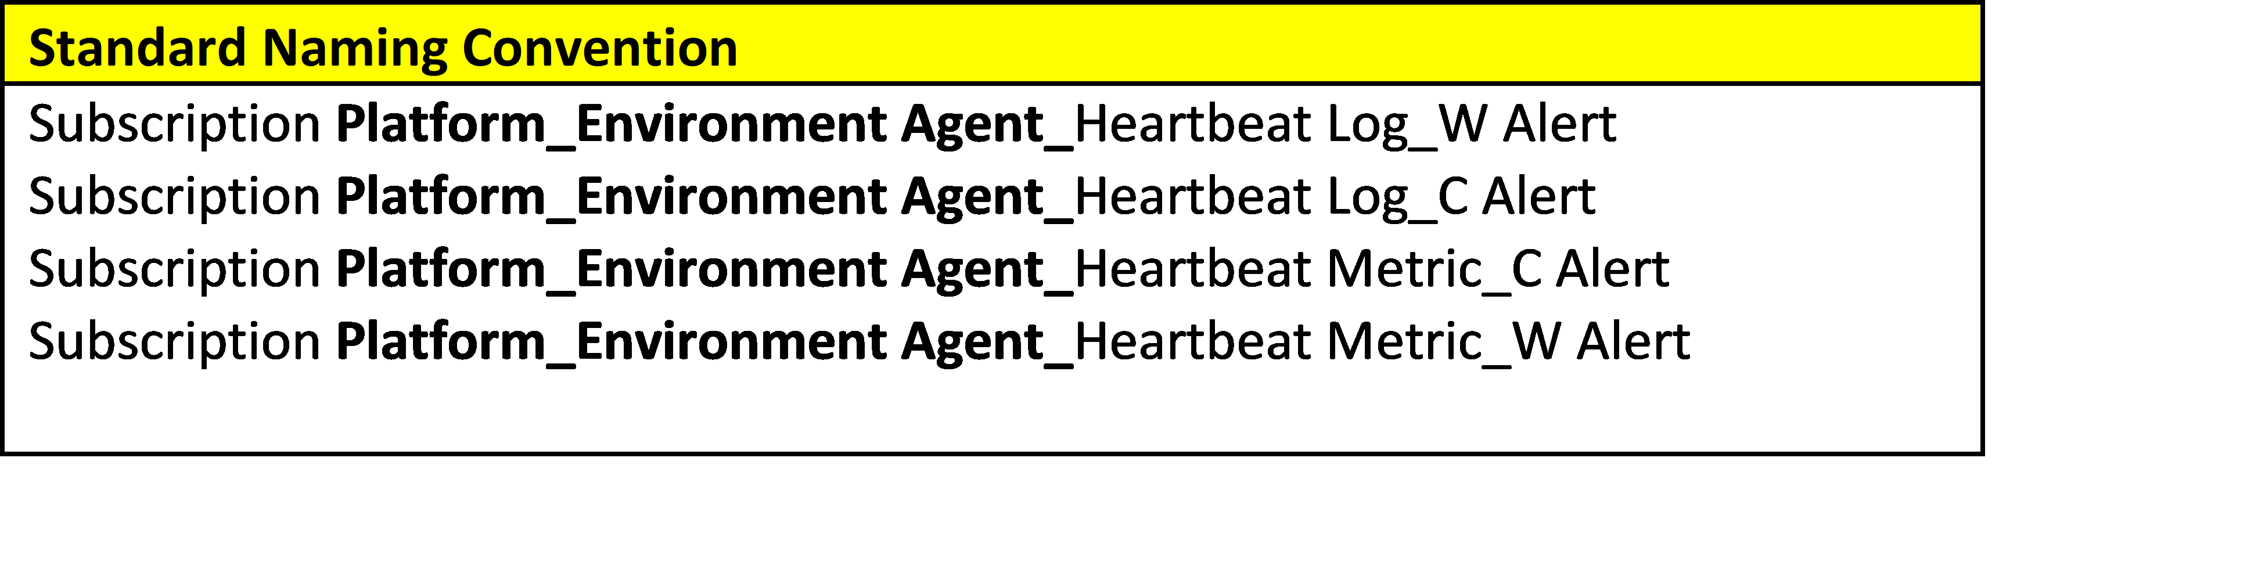
Naming Convention
A naming convention is a systematic method for naming a resource. A resource could be an Azure resources or service, a file name or pretty much anything else that should have a logical name. We have Alerts for below mentioned Services in our Uniper environment.
Application
Infrastructure
Resource
Heartbeat
Naming Convention for Application Service
Naming Convention for Infrastructure Service
Naming Convention for Resource Service
Naming Convention for Heartbeat Service

Slide 16
Application Deployment

Slide 17
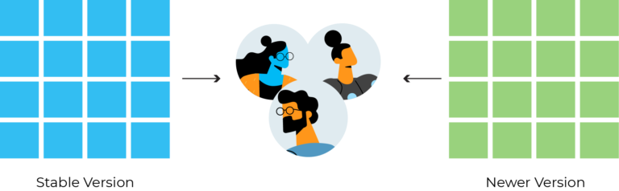
Application Deployments
Deployment strategies:
Blue/Green Deployment
A deployment strategy is any technique employed by DevOps teams to successfully launch a new version of the software solution they provide. These techniques cover how network traffic in a production environment is transitioned from the old version to the new version.
Blue/Green Deployment:-In this type of deployment strategy, the new version of the software runs alongside the old version. Here, the stable or the older version of the application is always blue , while the newer version is green. After the new version has been tested and certified to meet all the requirements, the load balancer automatically switches the traffic from the older version to the newer version.

Slide 18
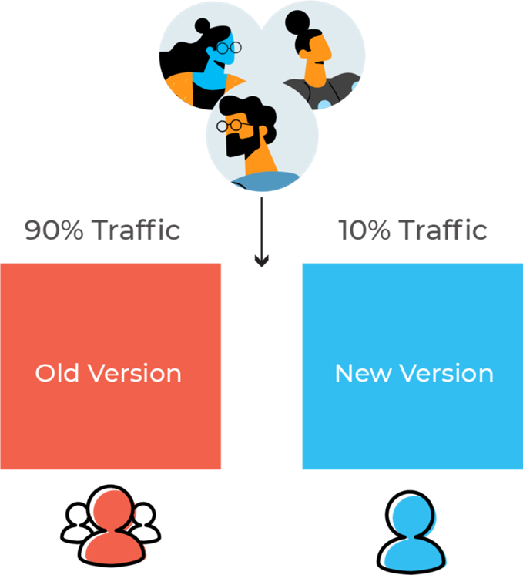
Canary Deployment
In canary deployment, the deployment team sets up the new version and then gradually shifts the production traffic from the older version to the newer version. For example, at a point in time during the deployment process, the older version might retain 90% of all traffic for the software while the newer version hosts 10% of the traffic. It uses live traffic from a subset of the end-users at different levels that varies as production occurs.

Slide 19
Helm
Helm helps you manage Kubernetes applications, Helm Charts help you define, install, and upgrade even the most complex Kubernetes application.
Helm packages are called charts, and they consist of a few YAML configuration files and some templates that are rendered into Kubernetes manifest files. Here is the basic directory structure of a chart:
charts: Manually managed chart dependencies can be placed in this directory, though it is typically better to use requirements.yaml to dynamically link dependencies.
templates: This directory contains template files that are combined with configuration values (from values.yaml and the command line) and rendered into Kubernetes manifests. The templates use the Go programming language’s template format.
Chart.yaml: A YAML file with metadata about the chart, such as chart name and version, maintainer information, a relevant website, and search keywords.
LICENSE: A plaintext license for the chart.
README.md: A readme file with information for users of the chart.
requirements.yaml: A YAML file that lists the chart’s dependencies.
values.yaml: A YAML file of default configuration values for the chart.

Slide 20
Application Observability and Maintenance

Slide 21
Liveness Probe
A liveness probe indicates if the container is operating:
If it succeeds, no action is taken, and no events are logged
If it fails, the kubelet kills the container, and it is restarted in line with the pod restartPolicy
A liveness probe is not necessary if the application running on a container is configured to automatically crash the container when a problem or error occurs. In this case, the kubelet will take the appropriate action—it will restart the container based on the pod’s restartPolicy.
When Should one use a Liveness Probe?

Slide 22
Liveness Probe Best Practices
The following best practices can help you make effective use of liveness probes. These best practices apply to Kubernetes clusters :
Prefer to use probes on applications that have unpredictable or fluctuating startup times
If you use a liveness probe on the same endpoint as a startup probe, set the failure Threshold of the startup probe higher, to support long startup times
You can use liveness and readiness probes on the same endpoint, but in this case, use the readiness probe to check startup behavior and the liveness probe to determine container health (in other words, downtime)
Defining probes carefully can improve pod resilience and availability. Before defining a probe, observe the system behavior and average startup times of the pod and its containers
Be sure to update probe options as an application evolves, or if you make infrastructure changes, such as giving the pod more or less system resources.

Slide 23
Readiness Probe
A readiness probe indicates whether the application running on the container is ready to accept requests from clients:
If it succeeds, services matching the pod continue sending traffic to the pod
If it fails, the endpoints controller removes the pod from all Kubernetes Services matching the pod
By default, the state of a Readiness probe is Failure.
Applications are temporarily unable to serve traffic. For example, an application might need to load large data or configuration files during startup, or depend on external services after startup. In such cases, you don't want to kill the application, but you don't want to send it requests either. Kubernetes provides readiness probes to detect and mitigate these situations. A pod with containers reporting that they are not ready does not receive traffic through Kubernetes Services.
Note:- Readiness probes runs on the container during its whole lifecycle.
Define readiness probes

Slide 24
Startup Probe
A startup probe indicates whether the application running in the container has fully started:
If it succeeds, other probes start their diagnostics. When a startup probe is defined, other probes do not operate until it succeeds
If it fails, the kubelet kills the container, and is restarted in line with the pod restartPolicy

Slide 25
Startup Probe Best Practice
The following best practices can help make effective use of startup probes. These best practices apply to Kubernetes clusters :
Prefer to use probes on applications that have unpredictable or fluctuating startup times
If you use a Startup probe on the same endpoint as a startup probe, set the failure Threshold of the startup probe higher, to support long startup times
Defining probes carefully can improve pod resilience and availability. Before defining a probe, observe the system behavior and average startup times of the pod and its containers
Be sure to update probe options as an application evolves, or if you make infrastructure changes, such as giving the pod more or less system resources.

Slide 26
Monitor Azure Kubernetes Service(AKS) with Prometheus and Grafana
Monitoring Deployment process
We are having 2 Monitoring Solution
1.Prometheus 2.Grafana
Introduction
Prometheus is an open-source systems monitoring and alerting toolkit
Prometheus collects and stores its metrics as time series data, i.e. metrics information is stored with e timestamp at which it was recorded, alongside optional key-value pairs called labels.
Components
The Prometheus ecosystem consists of multiple components, many of which are optional:
a. the main Prometheus server which scrapes and stores time series data
b. client libraries for instrumenting application code
c. a push gateway for supporting short-lived jobs
d. special-purpose exporters for services like HAProxy, StatsD, Graphite, etc.
e. an alert manager to handle alerts
Deployment Process
We are using Helm to deploy the solution
Grafana is a web application that is used to visualize the metrics that Prometheus collects. It will not produce any metrics but collects and displays them in a way that’s easy to understand through plots, charts and dashboards.

Slide 27
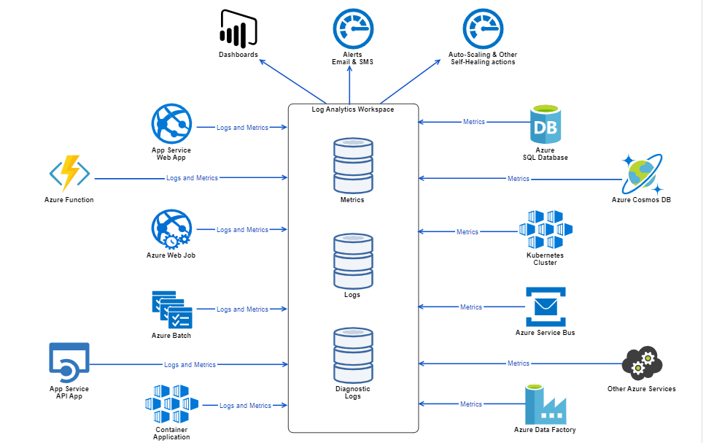
Architectural Representation of the Monitoring Solution

Slide 28
Monitoring Benefits
Provides a single pane of glass over our applications and infrastructure
Provides dashboards that allow our technology teams to get deeper insights into our applications and infrastructure
Give our technology teams piece of mind, knowing they will be pro-active alerted whenever a metric deteriorates beyond specific thresholds
d. Acts to automatically remedy some problems with our infrastructure whenever a metric deteriorates beyond specific thresholds
Components
The main components of the monitoring solution are described below: -
Log Analytics Workspace
This is one of the core components of Azure Monitor.
It is a central repository that holds the logs and metrics generated by our applications and infrastructure components, like databases and app services.
The other components, like dashboards and alerts, use the Log Analytics Workspace as their source of data.

Slide 29
Components
Dashboards
Dashboards provides a single pane of glass over our applications and infrastructure, as well as allowing the technical teams to drill-down into the specific details of each application.
Alerts
Alerts proactively notify us when issues arise with our infrastructure or applications. They allow us to identify and address these issues before our users notice them.
Alerts are configured with rules that define the criteria for the actions to be triggered. An example of a rule would be when the Average CPU Utilization goes past 80%, and the action could be to send an email or SMS message to a specific group of people.
Self-Healing Actions
These are actions tailored to keep our our infrastructure and applications running even in the face of unexpected events or loads.
The main action here is Autoscale, although we have a big variety of other actions that could be used to deploy new infrastructure components or adjust application configurations.
Autoscale enable us to have the right number of resources running to handle the load on our applications at any point in time. It can automatically add resources to handle increases in load and remove resources when they are idle, helping us to achieve scalability in a cost-effective manner.

Slide 30
Upgrade an AKS cluster
AKS cluster lifecycle involves performing periodic upgrades to the latest Kubernetes version. It’s important you apply the latest security releases, or upgrade to get the latest features.
Patch of own images:-Build the image and push it to unipercontainerregistry through azure Devops pipeline.
During the upgrade process, AKS will:
Add a new buffer node (or as many nodes as configured in max surge) to the cluster that runs the specified Kubernetes version.
Cordon and drain one of the old nodes to minimize disruption to running applications. If you're using max surge, it will cordon and drain as many nodes at the same time as the number of buffer nodes specified.
Cordoning a node means that it will be marked unschedulable, so new pods can no longer be scheduled to the node.
Drain:- After the node is made unschedulable, the drain command will try to evict the pods that are already running on that node. If eviction is supported on the cluster (from Kubernetes version 1.7) the drain command will use the Eviction API that takes disruption budgets into account, if it’s not supported it will simply delete the pods on the node.
When the old node is fully drained, it will be reimaged to receive the new version, and it will become the buffer node for the following node to be upgraded.
This process repeats until all nodes in the cluster have been upgraded. At the end of the process, the last buffer node will be deleted, maintaining the existing agent node count and zone balance.
Kubernetes has a resource type - poddisruptionbudget, or pdb - that can be attached to a deployment via labels.
A PDB limits the number of pods of a replicated application that are down simultaneously from voluntary disruptions.

Slide 31
AKS components update (kured, nginx, CSI driver)
AKS team will update to Application team through mail 6 weeks prior of the Prod clusters Patching and 4 weeks prior to the other environments.
We will send email notifications to the corresponding teams for upgrading the components and its versions table and do changes in the latest versions.
Upgrade Kured:
Kured (KUbernetes REboot Daemon) is a Kubernetes daemonset that performs safe automatic node reboots when the need to do so is indicated by the package management system of the underlying OS.

Slide 32
Application Environment, Configuration and Security

Slide 33
Kubernetes Namespaces
Namespaces can be ordered via the CloudWorks Services.
If you have used namespaces already the main differences during migration are:
Define resource quota for your namespace When submitting a request for a namespace you will be asked for the CPU and memory quota to reserve for the namespace. Information on how to determine these values can be found here: Resource quotas. Adjust network policy for your namespace if necessary The default network policy provided with your namespace will allow incoming communication via the default ingress controller and via internal load balancers but would block communication to other application namespaces within the cluster. If this is required you should adjust the network policy accordingly, see Network policies.

Slide 34
Resource Requirement
As you develop and run applications in Azure Kubernetes Service (AKS), there are a few key areas to consider. How you manage your application deployments can negatively impact the end-user experience of services that you provide. To succeed, keep in mind some best practices you can follow as you develop and run applications in AKS.
Define pod resource requests and limits
Use pod requests and limits to manage the compute resources within an AKS cluster. Pod requests and limits inform the Kubernetes scheduler which compute resources to assign to a pod.
Pod CPU/Memory requests
Pod requests define a set amount of CPU and memory that the pod needs regularly.
Pod CPU/Memory limits**
Pod limits set the maximum amount of CPU and memory that a pod can use.

Slide 35
Resource Quota
When several users or teams share a cluster with a fixed number of nodes, there is a concern that one team could use more than its fair share of resources.
Resource quotas are a tool for administrators to address this concern.
A resource quota, defined by a ResourceQuota object, provides constraints that limit aggregate resource consumption per namespace. It can limit the quantity of objects that can be created in a namespace by type, as well as the total amount of compute resources that may be consumed by resources in that namespace.
Resource quotas working methodology
Different teams work in different namespaces. This can be enforced with RBAC.
The administrator creates one ResourceQuota for each namespace.
Users create resources (pods, services, etc.) in the namespace, and the quota system tracks usage to ensure it does not exceed hard resource limits defined in a ResourceQuota.
If creating or updating a resource violates a quota constraint, the request will fail with HTTP status code 403 FORBIDDEN with a message explaining the constraint that would have been violated.
If quota is enabled in a namespace for compute resources like CPU and memory, users must specify requests or limits for those values; otherwise, the quota system may reject pod creation. Hint: Use the LimitRanger admission controller to force defaults for pods that make no compute resource requirements.
You can limit the total sum of compute resources that can be requested in each namespace.
limit.cpu and limit.memory

Slide 36
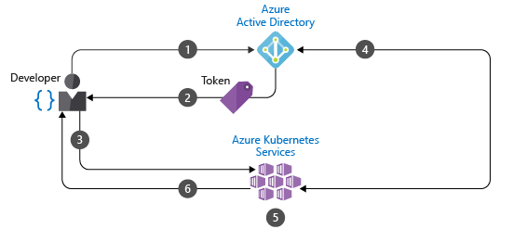
Authentication, Authorization and Admission control
Authentication:- Authenticate AKS cluster users with Azure Active Directory (Azure AD).
Developer authenticates with Azure AD.
2. The Azure AD token issuance endpoint issues the access token.
3. The developer performs an action using the Azure AD token, such as kubectl create pod.
4. Kubernetes validates the token with Azure AD and fetches the developer's group memberships.
5. Kubernetes RBAC and cluster policies are applied.
Admission Controllers:-An admission controller is a piece of code that intercepts requests to the Kubernetes API server prior to persistence of the object, but after the request is authenticated and authorized

Slide 37
RBAC Authorization
Role-based access control (RBAC) is a method of regulating access to computer or network resources based on the roles of individual users within your organization.
Control access to cluster resources using role-based access control and Azure Active Directory identities in Azure Kubernetes Service.
RBAC authorization uses the rbac.authorization.k8s.io API group to drive authorization decisions, allowing you to dynamically configure policies through the Kubernetes API.
HaCT managed containers are enabled with RBAC and has been architecture for sharing a single Azure Kubernetes service cluster with multiple tenants. Each and every hosted application have been logically placed under a single namespace managed by 'Namespace Admin’.
RBAC in Kubernetes
Let's understand some of the key terminologies associated with RBAC in Azure Kubernetes Service :
Subjects: The set of users(Cluster, Namespace Admin and Users(custom)) and processes that want to access the Kubernetes API.
Resources: The set of Kubernetes API Objects available in the cluster. Examples include Pods, Deployments, Services, Nodes, and Persistent Volumes, among others.
Verbs(Operations): The set of operations that can be executed to the resources, different verbs are available (examples: get, watch, create, delete, etc.), but ultimately all of them are Create, Read, Update or Delete (CRUD) operations.
Roles and RoleBinding:-
HaCT managed containers(AKS) works on concepts of Roles and Role Bindings : Role object has permission what a user can do or not and Role Binding is an object which binds a User i.e., ‘email or AAD group or service account’ to the Role you define. You can go through the attached yaml for actual representation. You can modify the yaml to provide/restrict user access scoped to AKS resources.

Slide 38
Secrets
The CSI-driver provides a way to connect secrets, keys and certificates in Key Vault to deployments in Kubernetes and it allows you to do is mount secrets stored in a vault to your pods.
In order to access the secrets stored in key vault Pod Identity need to be configured into the cluster.
AKS users can use TLS certificates for securing and accessing their applications in AKS Containers over the internet.
When considering multi-tenancy architecture, its always a question how safe is my data or secrets are safer. Storing TLS secrets under namespaces is not the best practices. So, We took care of this by storing the Certificates and its TLS secretes safely in Azure Key Vault. And retrieving and updating them into AKS cluster on demand [ i.e.at the time of cluster creation or cluster updating with new TLS or expired TLS or certs ]
Features
Mounts secrets, keys, and certificates to a pod by using a CSI volume
Supports CSI inline volumes
Supports mounting multiple secrets store objects as a single volume
Supports pod portability with the SecretProviderClass CRD
Supports Windows containers
Syncs with Kubernetes secrets
Supports auto rotation of mounted contents and synced Kubernetes secrets

Slide 39
Security Contexts
In Kubernetes, a security context defines privileges for individual pods or containers. You can use security context to grant containers or pods permissions such as the right to access an external file or run-in privileged mode.
Azure Policies (Audit, Deny, Disabled)
1. Authorized IP ranges should be defined on Kubernetes Services
2. Azure Policy Add-on for Kubernetes service (AKS) should be installed and enabled on your clusters
3. Deploy GitOps to Kubernetes cluster
4. Enforce HTTPS ingress in Kubernetes cluster: enforces HTTPS ingress in a Kubernetes cluster. (Audit, Deny)
5. Enforce internal load balancers in Kubernetes cluster: enforces load balancers do not have public IPs in a Kubernetes cluster. (Audit, Deny)
6. Enforce labels on pods in Kubernetes cluster: enforces the specified labels are provided for pods in a Kubernetes cluster. (Audit, Deny)
7. Ensure container CPU and memory resource limits do not exceed the specified limits in Kubernetes cluster: ensures container CPU and memory resource limits are defined and do not exceed the specified limits in a Kubernetes cluster. (Audit, Deny)
8. Ensure only allowed container images in Kubernetes cluster
9. Kubernetes Services should be upgraded to a non-vulnerable Kubernetes version: Upgrade your Kubernetes service cluster to a later Kubernetes version to protect against known vulnerabilities in your current Kubernetes version. (Audit)
10. Role-Based Access Control (RBAC) should be used on Kubernetes Services: RBAC should be used (Audit)

Slide 40
Services and Networking

Slide 41
AKS Namespace and Global n/w policy
Namespace Network Policy is applicable to AKS namespaces.
The Kubernetes Namespace Network policy allows communication between pods in the same namespace and it denies pods to communicate to another namespace pods.
The Kubernetes Network Namespace policy allows Ingress traffic from only Ingress-controller namespace pods.
The Kubernetes Network Namespace policy allows Ingress traffic from other namespaces pods only if the namespace is explicitly allowed in the namespace ingress traffic section of the network policy.

Slide 42
Calico Global Network Policy
If types has no value, Calico defaults as follows.
Network Policy
A global network policy resource (GlobalNetworkPolicy) represents an ordered set of rules which are applied to a collection of endpoints that match a label selector.
GlobalNetworkPolicy is not a namespaced resource. GlobalNetworkPolicy applies to workload endpoint resources in all namespaces, and to host endpoint resources (an interface or group of interfaces on a host).
The Calico global network policy is applicable at Cluster level.
The Calico Global Network Policy allows the communication from Ingress-controller Namespace pods along with DNS resolution using Kube-System Namespace via Ingress traffic types rules.
The Calico Global Network Policy allows the communication to all the external networks along with DNS resolution.
Ingress Rules Present | Egress Rules Present | Types value
No | No | Ingress
Yes | No | Ingress
No | Yes | Egress
Yes | Yes | Ingress, Egress

Slide 43
Service
In a container-based, microservices approach to application development, application components work together to process their tasks. Kubernetes provides various resources enabling this cooperation:
You can connect to and expose applications internally or externally.
You can build highly available applications by load balancing your applications.
For your more complex applications, you can configure ingress traffic for SSL/TLS termination or routing of multiple components.
For security reasons, you can restrict the flow of network traffic into or between pods and nodes.
In Kubernetes:
Services logically group pods to allow for direct access on a specific port via an IP address or DNS name.
You can distribute traffic using a load balancer.
More complex routing of application traffic can also be achieved with Ingress Controllers.
. Security and filtering of the network traffic for pods is possible with Kubernetes network policies.

Slide 44
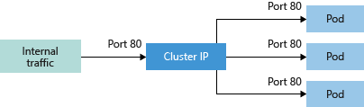
Access to application via services (1/3)
To simplify the network configuration for application workloads, Kubernetes uses Services to logically group a set of pods together and provide network connectivity. The following Service types are available:
Cluster IP:-Creates an internal IP address for use within the AKS cluster. Good for internal-only applications that support other workloads within the cluster.
Diagram showing Cluster IP traffic flow in an AKS cluster

Slide 45
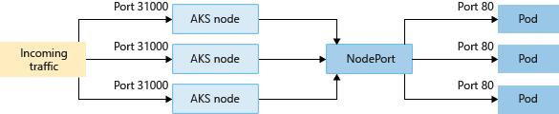
Access to application via services (2/3)
NodePort
Creates a port mapping on the underlying node that allows the application to be accessed directly with the node IP address and port. This Node port services are used only for error analysis.
LoadBalancer
Creates an Azure load balancer resource, configures an external IP address, and connects the requested pods to the load balancer backend pool. To allow customers' traffic to reach the application, load balancing rules are created on the desired ports.
External load balancers are forbidden in our environment and can be used for error analysis.

Slide 46
Access to application via services (3/3)
ExternalName
Creates a specific DNS entry for easier application access.
Network Policies:
AKS network policy is a specification of how groups of pods are allowed to communicate with each other and other network endpoints. NetworkPolicy resources use labels to select pods and define rules which specify what traffic is allowed to the selected pods.
AKS network policy is generally available through the Azure native policy plug-in or through the community project Calico and can be used with kubenet or Azure CNI network-plugin.
Ref: https://docs.microsoft.com/en-us/azure/aks/use-network-policies

Slide 47
Ingress to expose applications
In order to have communication into the AKS cluster a managed Nginx ingress controller is provided by HaCT inside the AKS system namespace. This ingress controller should be used by all applications for ingress traffic.
Application teams only must define a suitable ingress definition to route traffic from the ingress controller to their service (of type Cluster IP) inside their namespace. It is also possible to create a dedicated ingress controller for a namespace upon request. In this case the application team is responsible for its maintenance and support. The private IP address of the internal load balancer for the ingress controller is fixed and must be used for DNS entries to route traffic to the AKS cluster based on DNS names.

Slide 48
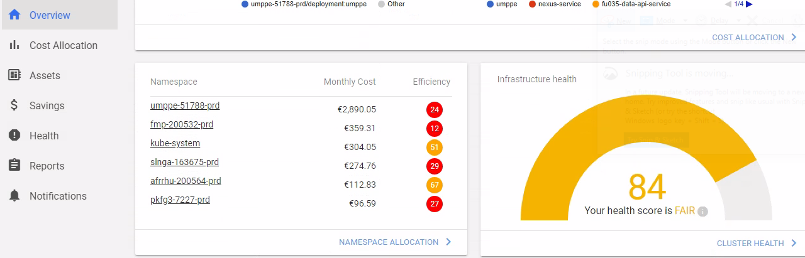
Kubecost
Kubecost allows you to see allocated spend across all native Kubernetes concepts, so you can provide your teams with transparent, accurate cost data reconciled with your actual cloud bill. Break down costs by namespace, deployment, service, and more across any major cloud provider or on-prem Kubernetes environment.
We can access the Kubecost using the below url in different environments
cmcaks-pre-001 - https://aks-grafana-dev.uniperapps.com
cmcaks-prd-001 - https://kubecost.uniperapps.com
cmcaks-pre-hisech-001 - https://kubecost-dev-hisec.azure.uniper.energy
cmcaks-prd-hisech-001 - https://kubecost-prd-hisec.azure.uniper.energy

Slide 49
DevOps - Configure Azure DevOps integration
Goal of this service is to setup Service Connection for Azure DevOps Projects under Uniper Azure DevOps account. Using this service, user can raise request to create service connection for Resource group, HACT managed Azure Container registry and HACT managed V2 cluster namespace .
The requester submits a ServiceNow service Request to create Service Connection for their project in the Azure DevOps Uniper account. The HACT Development Team validates the provided input. If not, all required information is available, the request will be returned to the requester. If all required input is available, the HACT Development team creates Service Connection for their project Uniper Azure DevOps account.

Slide 50
Service Connection
Service Connection for Resource Group
The HACT Development Team validates the provided input and if all inputs and approvals are in place, team will setup connection using cmcservices automation portal. Post completion of service connection, HACT development team will do the verification (steps below) to ensure everything is fine.
B. Service Connection for HACT managed Azure Container registry:
The HACT Development Team validates the provided input and if all inputs and approvals are in place, team will raise a request for service principle into Directory Services queue. Once DS team provides service principle, team will follow the below steps to create service connection.
1. Verify service principle
2. Create service principle secret
3. Assign acrPull, acrPush and reader permission to service principle for registry
4. Setup service connection
5. Grant access permission to all pipelines check-box is checked
C. Service Connection for HACT managed V2 cluster namespace:
The HACT Development Team validates the provided input and if all inputs and approvals are in place, team will setup connection by following the below step.
1. Choose kubernetes as connection type
2. Select Azure Subscription
3. Select cluster and respective namespace
4. Provide connection name

Slide 51
DevOps - Create new Azure DevOps project
Goal of this service is to setup projects in Azure DevOps. The project will be handed over to the assigned Project Administrator. The assigned Project Administrator has permissions to administer all aspects of teams and team project but cannot create team projects.
The requester submits a ServiceNow service Request to create a new project in the Azure DevOps Uniper account. The HACT Development Team validates the provided input. If not all required information is available, the request will be returned to the requester. If all required input is available, the HACT Development team creates the project with the name in the Uniper Azure DevOps account.
The User assigned as Project Administrator will then be setup with access level ‘Basic’ on the Uniper Azure DevOps account, if not already there, and get Project Administrator rights assigned for the project. HACT will ensure there are sufficient user licences for level ‘Basic’ available and add a licence to the associated Azure DevOps Azure subscriptions if needed.
HACT development team will create “HACT OPERATION SUPPORT” group into the project and add “AZ-CMC-DEV-TEAM” AD group to that. After that, “HACT OPERATION SUPPORT” will add to project administrator group. Once done, remove individual HACT development team from project administrator.
When the setup has been completed, Development team will add comment in ServiceNow request and change the status to review pending with requester. ServiceNow will then send email to requester with comment and status.

Slide 52
AKS - Resource Quota & Limit Ranges
Default section - sets up the default limits for a container in a pod. If you set these values in the limitRange, any containers that don’t explicitly set these themselves will get assigned the default values.
DefaultRequest section - sets up the default requests for a container in a pod. If you set these values in the limitRange, any containers that don’t explicitly set these themselves will get assigned the default values.
Max section - Sets up the maximum limits that a container in a Pod can set. The default section cannot be higher than this value. Likewise, limits set on a container cannot be higher than this value. It is important to note that if this value is set and the default section is not, any containers that don’t explicitly set these values themselves will get assigned the max values as the limit.
Min section - Sets up the minimum Requests that a container in a Pod can set. The defaultRequest section cannot be lower than this value. Likewise, requests set on a container cannot be lower than this value either. It is important to note that if this value is set and the defaultRequest section is not, the min value becomes the defaultRequest value too.

Slide 53
AKS V2 - Resource Utilization Tool - KubeCost
Kubecost is a popular solution for Kubernetes cost monitoring. We examine the functionality, benefits, and more to help you determine if it is worth the cost.
How Kubecost Works
Kubecost collects real-time data from your Kubernetes cluster and analyzes it, giving you a detailed cost breakdown. Kubecost, which is specifically designed to work with Kubernetes, uses these metrics and cost categories:
METRICS USED COST CATEGORIES
Time in running state Monthly cluster cost
Consumed and reserved resources Deployment resource cost
Price of resources consumed or reserved Cost efficiency
The Kubecost cost allocation model can analyze costs on any Kubernetes level, supporting native Kubernetes concepts including clusters, namespace, controller, deployment, service, label, pod, and container. Kubecost uses the data to tell you how to optimally tune nodes and pods. It finds underutilized nodes and storage, so that you can more effectively use or eliminate them.

Slide 54
Naming Convention
Azure Object / Resource | Naming Convention for Uniper | Example
Subscription Name | U + Connectivity- express Route "E" or S2S "S" (1) + Environment (4) + Sequence Number (2) | UEPROD01
IaaS Virtual Machine Name | [Subscription or Application or name][environment][Computer role][number] | Examples: sapprdrouter001 gtmprdsdb001
Resource Group Name | Subscription or Application name (3 to 7) + hyphen + xaas (X is P or I) + hyphen + environment (3) + hyphen + "rgp" + hyphen + Sequence number (3) | myapp-IaaS-tst-rgp-001
Azure SQL Database Name | [company name] [application name]-[environment] [type] [number]-[additional qualifier] | uni-portfolio-dev-sql001-colfr

Slide 55
Thank You
- Overall focus more on the application management side (patching of own container images, naming conventions, resource quota)
Kubecost is not mentioned at all
Azure DevOps is not mentioned at all
More guidance on monitoring and alerting should be given
Delete standard Kubernetes information that is not relevant in our environment
Refer to the public Wiki when suitable

